Slide 1
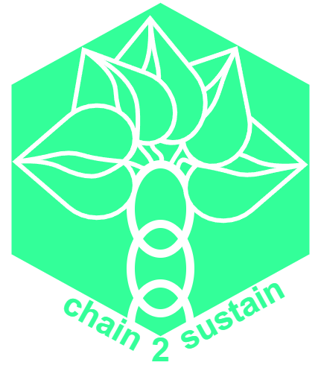

Chain2Sustain Sustainable Supply Chains based on Blockchain
Technische Universität München
Department of Informatics
Blockchain technology for public sector innovation
22nd of June, 2023

Slide 2

Notes:
What needs to be done:
Certify supply chain according to environmental, social and governance (ESG) standards.
Ensure:
No child labour
Environmentally friendly transport and logistics
Green production facilities with no pollution
Business is lead with the right values and without any discrimination
Needs to verifiable for auditors & customers
Establish trust between companies and customers
Separates a company from competitors (marketing)
Similar: Global Battery Alliance for Batteries

Slide 3

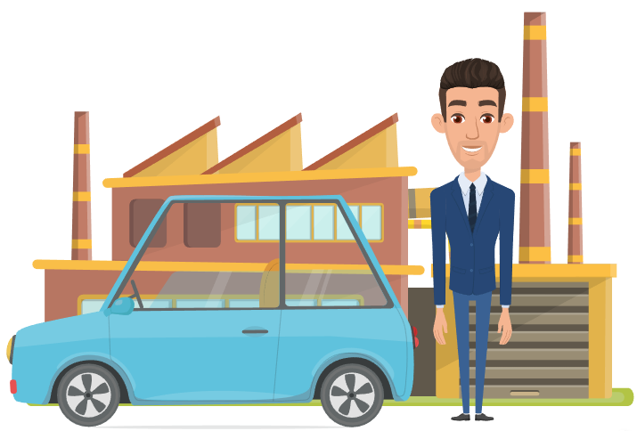

Main Stakeholder - Issues
Often not able to buy products with a clean conscience.
Customer
To satisfy customers, need of proof of a sustainable supply chain.
Cannot provide proof
OEM
Worried about retaining their business secrets
Suppliers
Notes:
Summarize to see how blockchain technology can solve many problems
General Issues:
Supply chains across the globe
Various (changing) business partners
No globally responsible authority
Blockchain Solutions offer
Exchange of goods accompanied by certificates into blockchain
Trusted and tamperproof environment
Traceability of materials and products along the entire chain
Does not require a central authority (=> distributed & decentralised)
Ability to preserve trade secrets while being able to verify the origin of products

Slide 4
How Blockchain can help
Issues:
Solution:
Often not able to buy products with a clean conscience.
Blockchain can proof a sustainable supply chain
Customer
To satisfy customers, need of proof of a sustainable supply chain.
Cannot provide proof
Blockchains can be trace-able, provide immutability, store relevant data and automate processes
OEM
Worried about retaining their business secrets
Blockchain can provide partial anonymity and data secrecy
Suppliers
Notes:
Summarize to see how blockchain technology can solve many problems
General Issues:
Supply chains across the globe
Various (changing) business partners
No globally responsible authority
Blockchain Solutions offer
Exchange of goods accompanied by certificates into blockchain
Trusted and tamperproof environment
Traceability of materials and products along the entire chain
Does not require a central authority (=> distributed & decentralised)
Ability to preserve trade secrets while being able to verify the origin of products

Slide 5
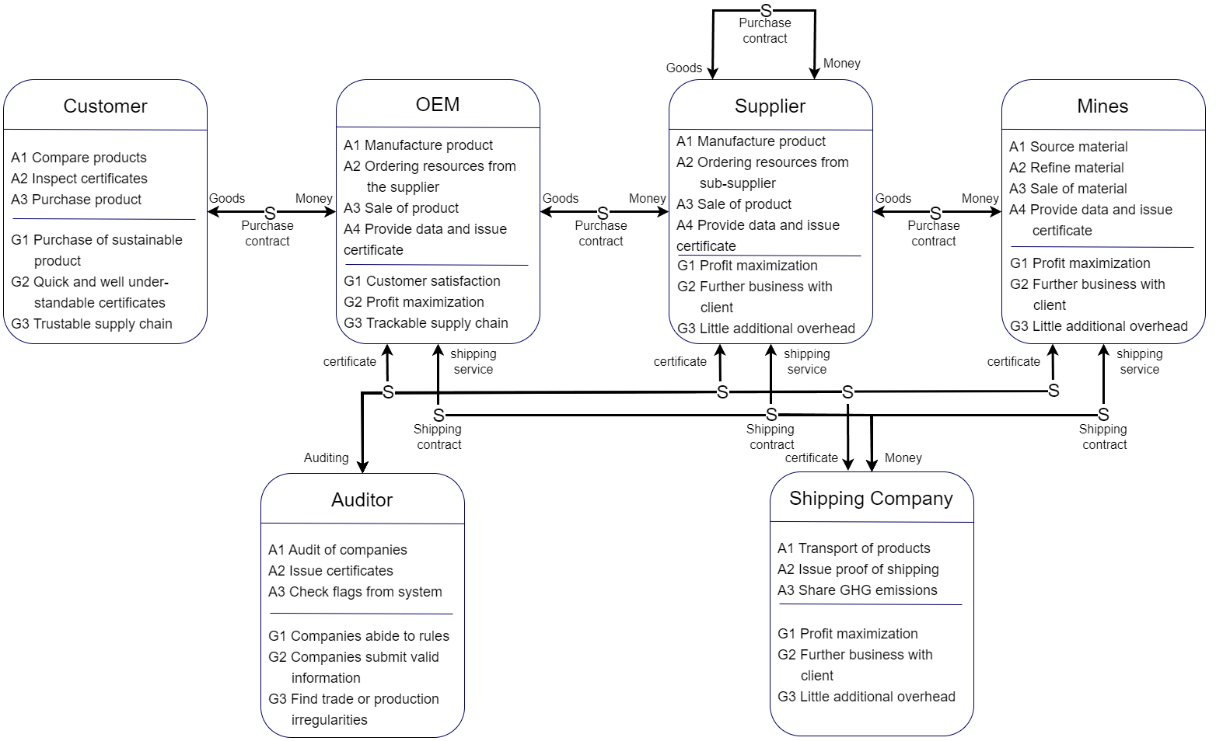
Stakeholder diagram

Slide 6
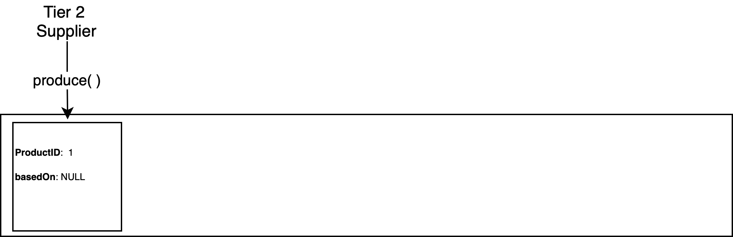
System Design

Slide 7
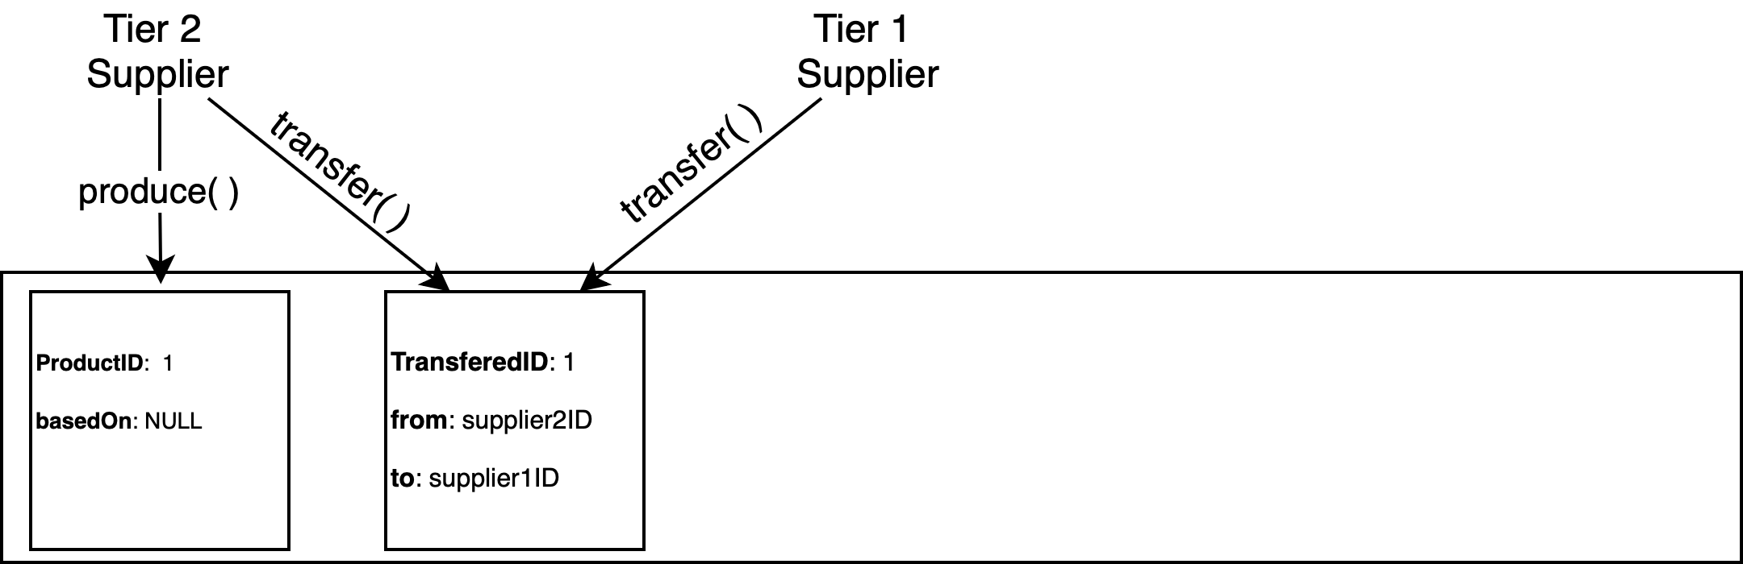
System Design

Slide 8
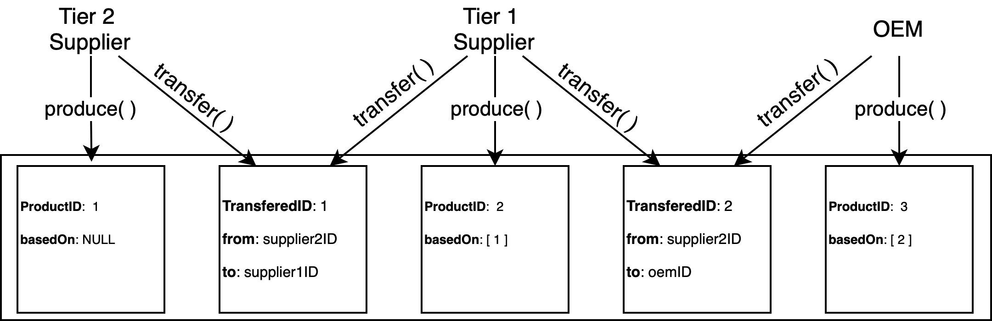
System Design

Slide 9
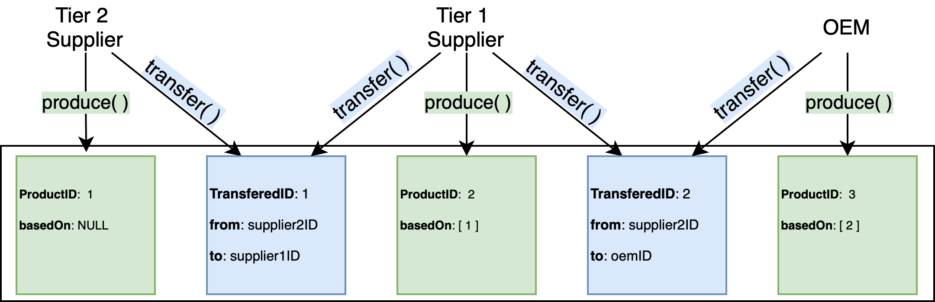
System Design
Chaincodes:
Produce Products
Transfer Products

Slide 10


System Design - Privacy
Private Data Collections
Identity Mixing

Slide 11
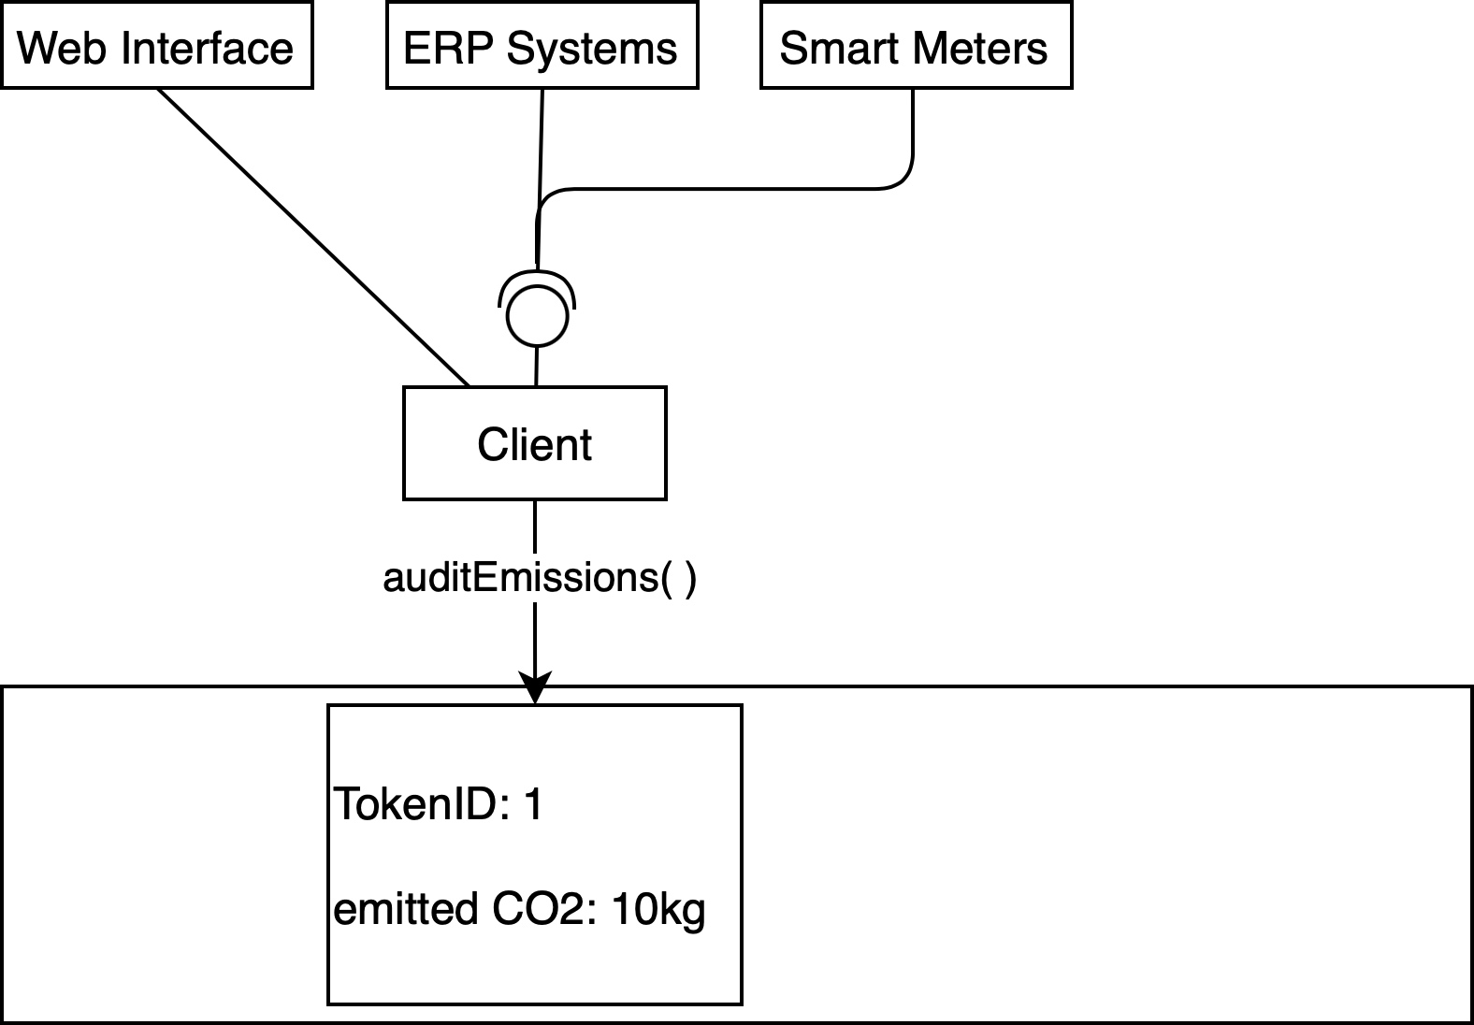
System Design – Emissions Input
Automated emissions auditing through chaincode
Transferable emissions tokens

Slide 12
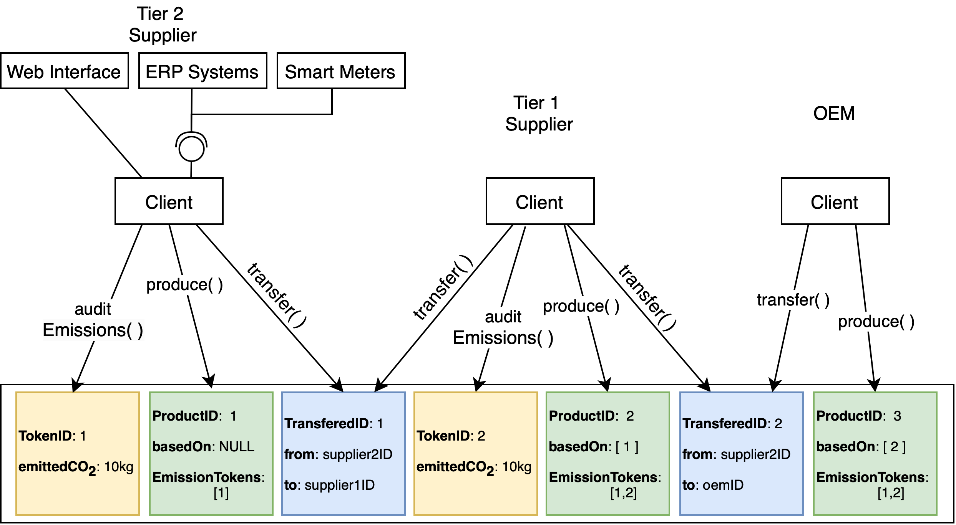
System Design

Slide 13



Technologies/Implementation
Why Hyperledger Fabric?
Scalability
Flexible design options
Consortium blockchain
Identity mixer and private data
Some previous experience
Good documentation
Why Fablo?
Easy to setup organizations and channels
Automatically creates credentials
Simplifies the setup of the design and management
Why NodeJS?
Go-to web interface creation tool
Prior experience

Slide 14
Technologies & Tools - Fablo
Creation of organization:
Creation of channel:
Creation of chaincode:
"orgs": [
{
"organization": {
"name": "Org1",
"domain": "org1.example.com"
},
"peer": {
"instances": 1,
"db": "LevelDb"
},
"tools": {}
}
],
"channels": [
{
"name": "my-channel1",
"orgs": [
{
"name": "Org1",
"peers": [
"peer0",
"peer1",
"peer2"
]
}
]
}
],
"chaincodes": [
{
"name": "chaincode1",
"version": "0.0.1",
"lang": "node",
"channel": "my-channel1",
"directory": "./chaincodes/chaincode-kv-node"
}
]

Slide 15
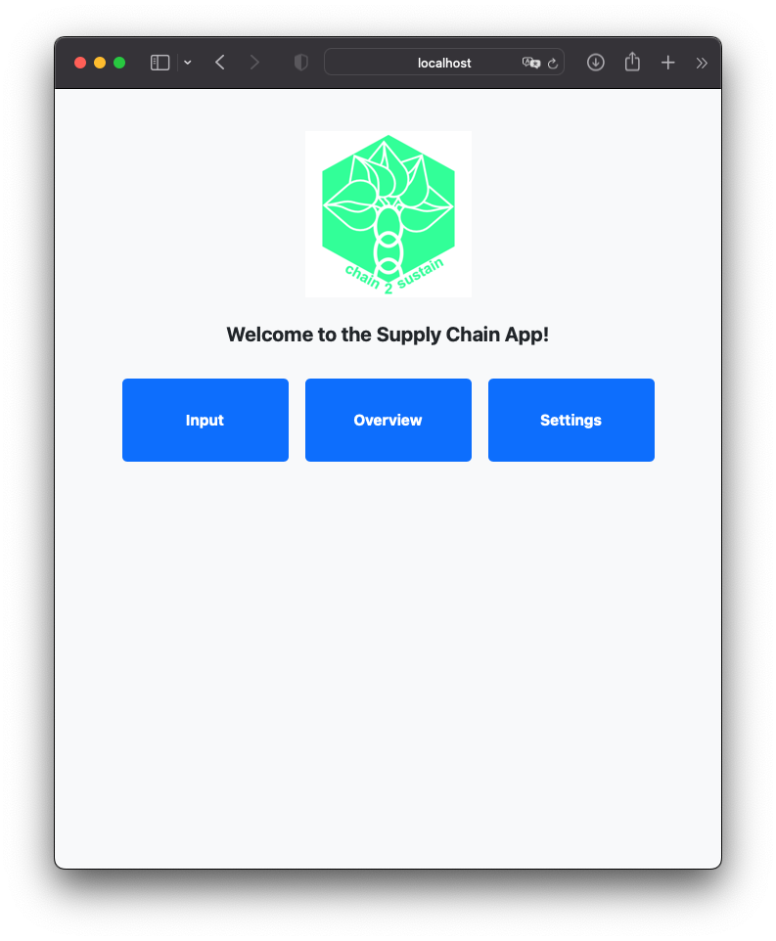
Client

Slide 16
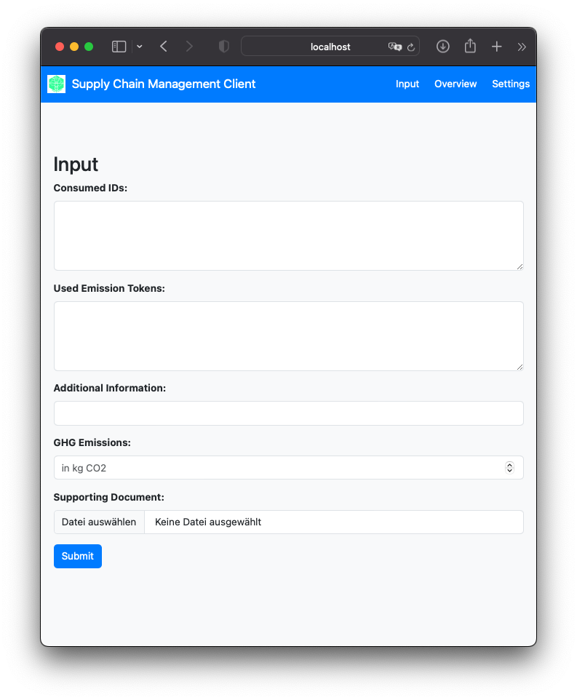
Client

Slide 17
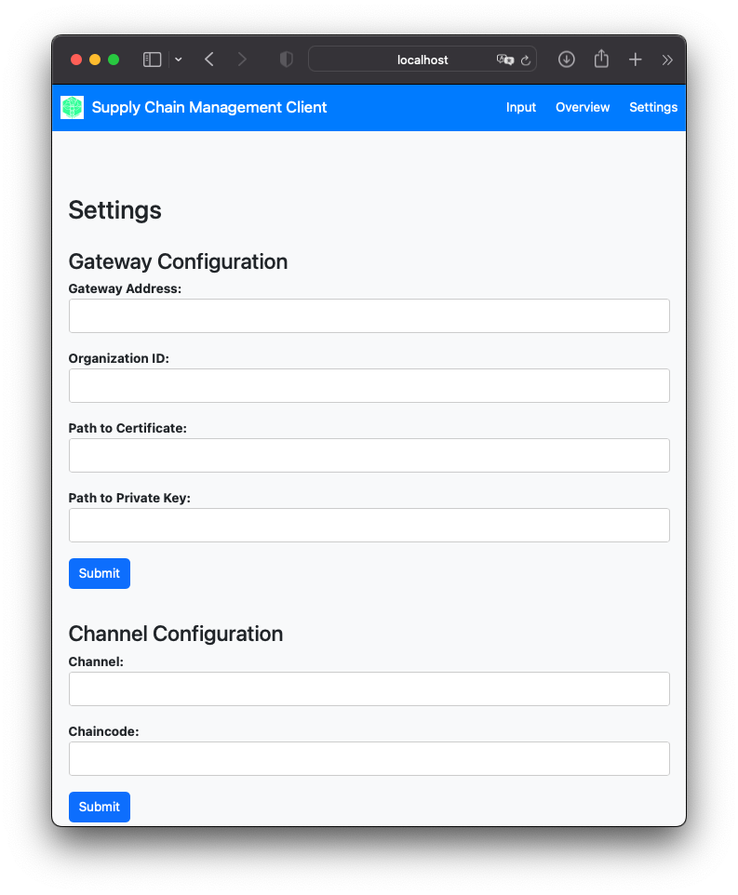
Client

Slide 18
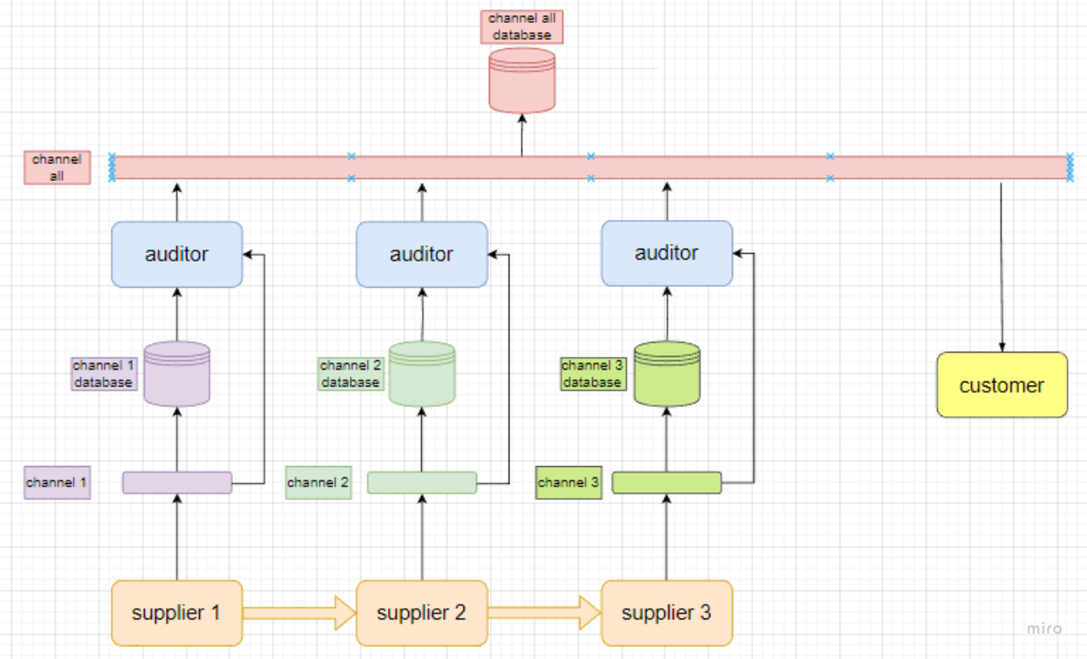
Past challenges
Privacy vs traceability

Slide 19
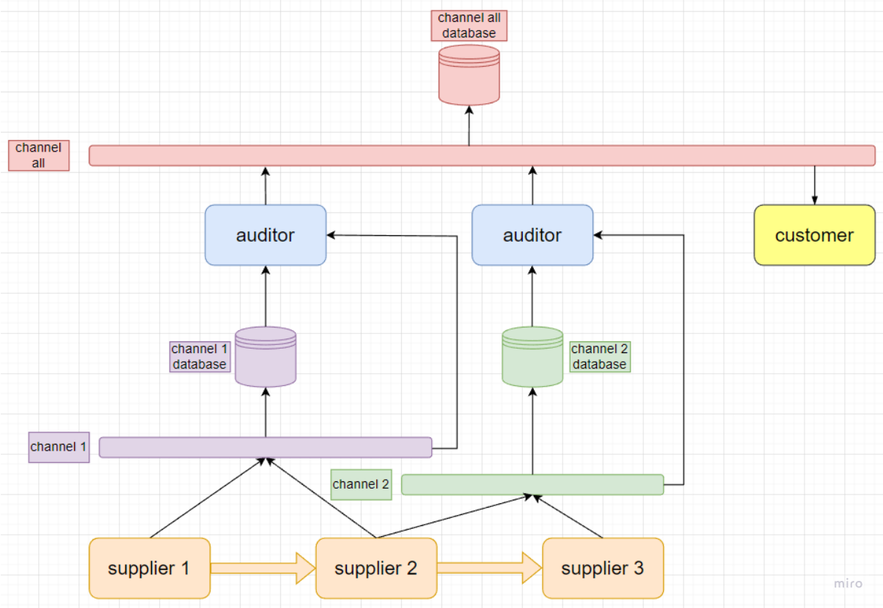
Past challenges
Information transfer between channels

Slide 20



Future challenges
Further work on design of:
Chaincode
Certificates
Look further into:
Private Data Collection
Identity Mixer
Token creation and integration into the system:
Tracing tokens without revealing Identity of Issuer

Slide 21
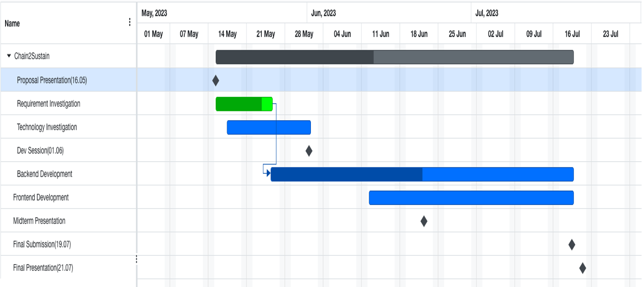
Roadmap

Slide 22
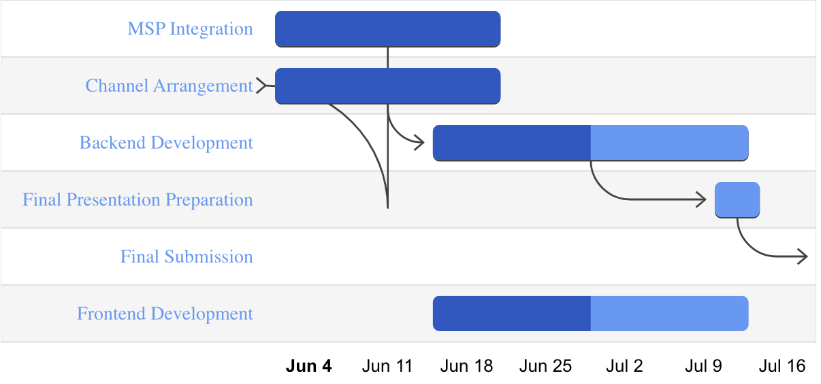
Roadmap – Slightly revised

Slide 23
Thank you for your attention and we are looking forward to the discussion!

Slide 24
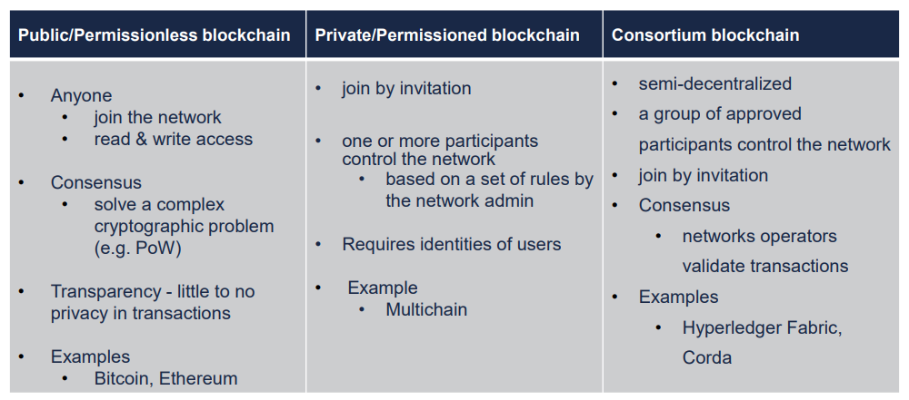
Proposal - Technology

Slide 25
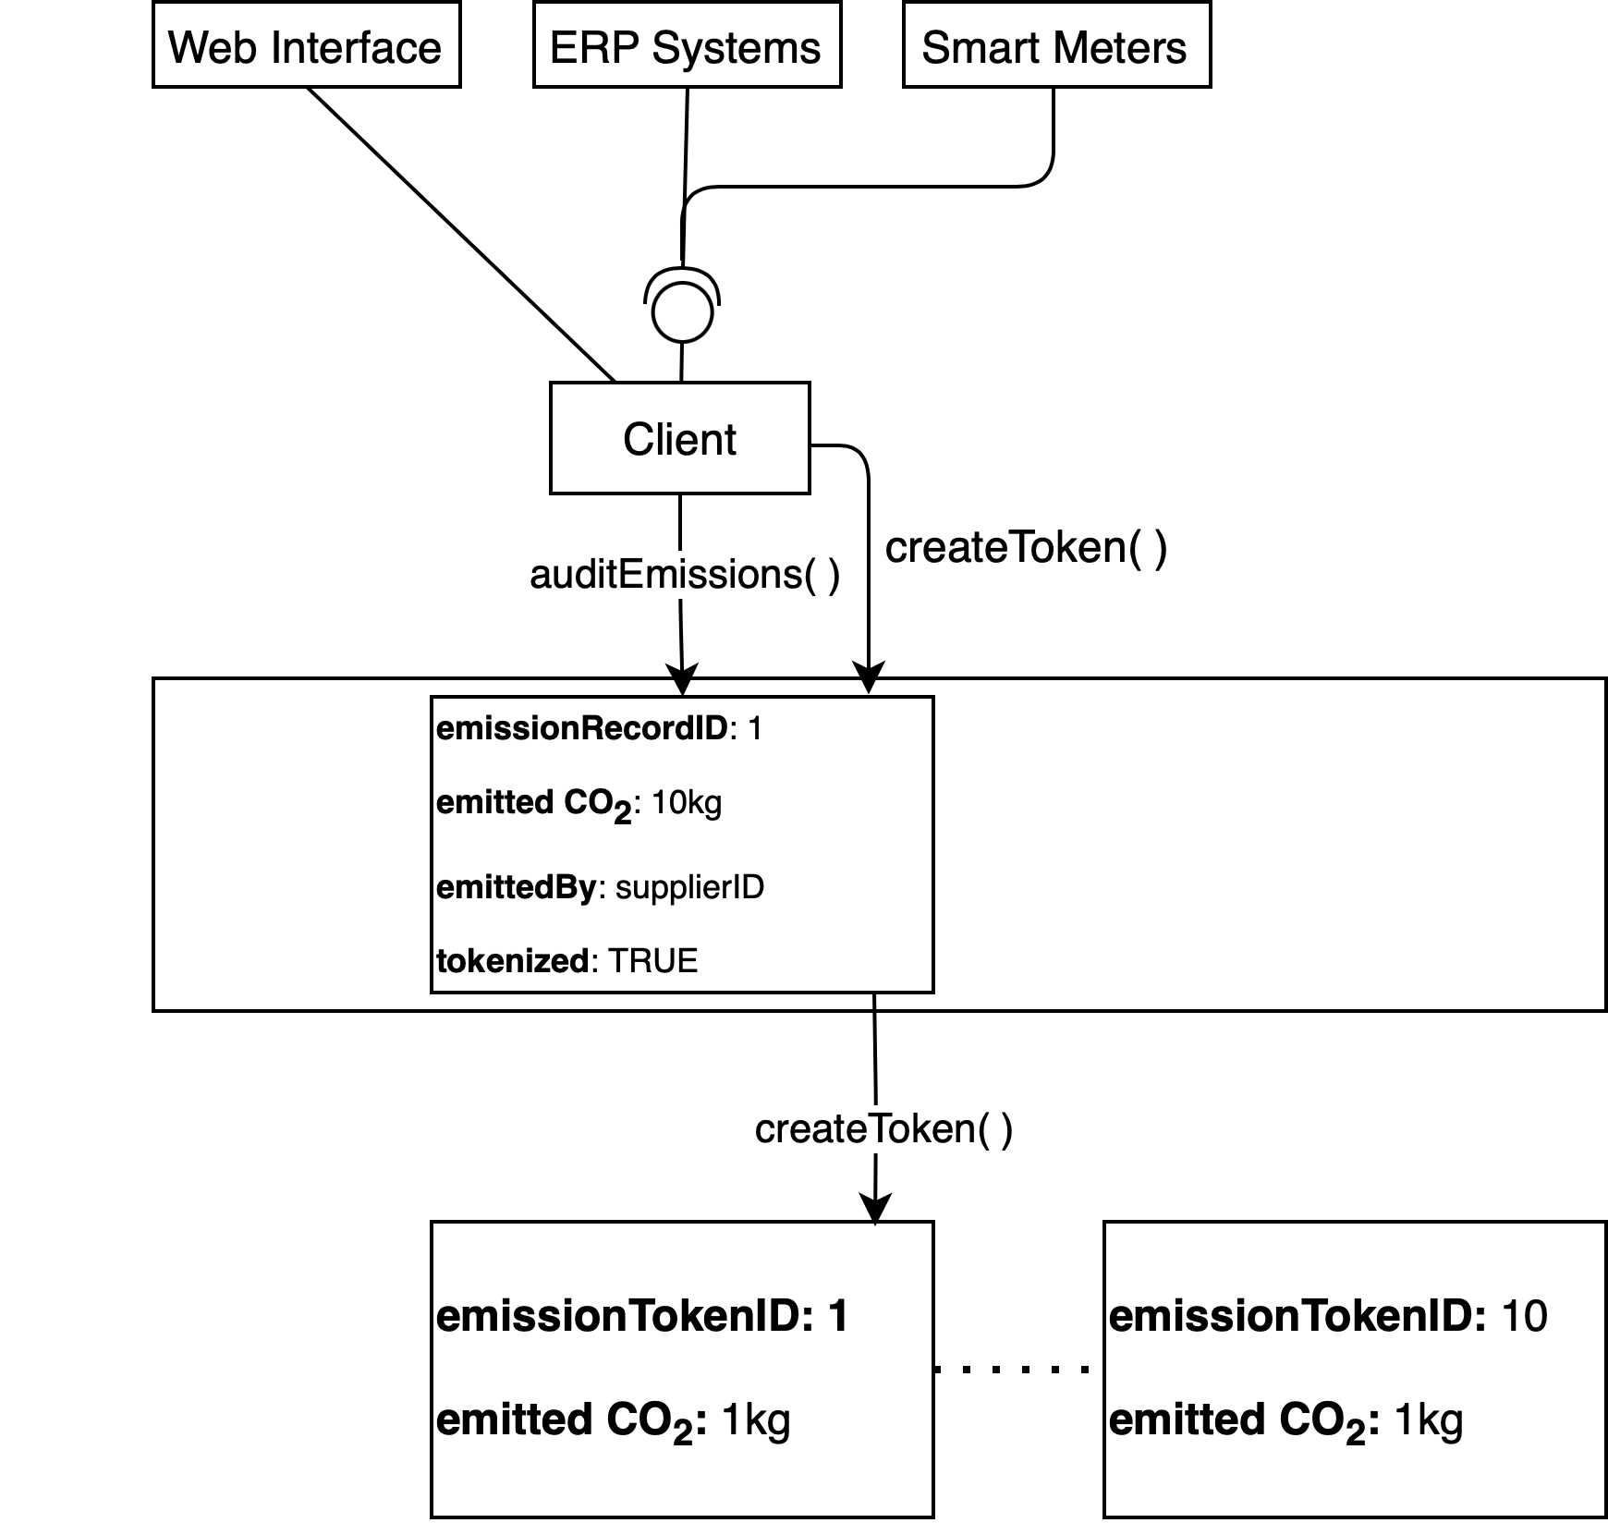
System Design Extension – Emission Records

Slide 26
Resources
https://www.industriall-union.org/report-due-diligence-across-the-battery-supply-chain
Global Battery Alliance - https://www.globalbattery.org
Icons: www.flaticon.com

